Slide 1
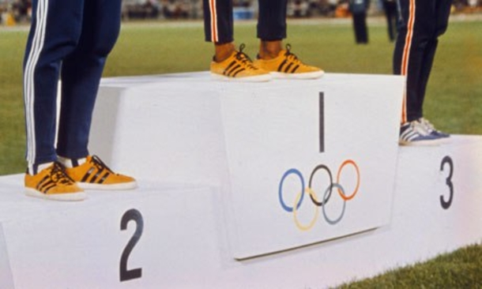

Who are the real winners of the Olympics?
Group 9
Linyuan Xing
Jingxin Nie
Mark Mendoza
Timothy Le Pers
Notes:
Good afternoon everyone,
We are Group 9.
My name is Mark, and today I’m joined by Timothy – and we will be presenting on behalf our other members Linyuan and Jingxin who are currently overseas.
We will be pitching our topic “the real winners of the Olympics”

Slide 2
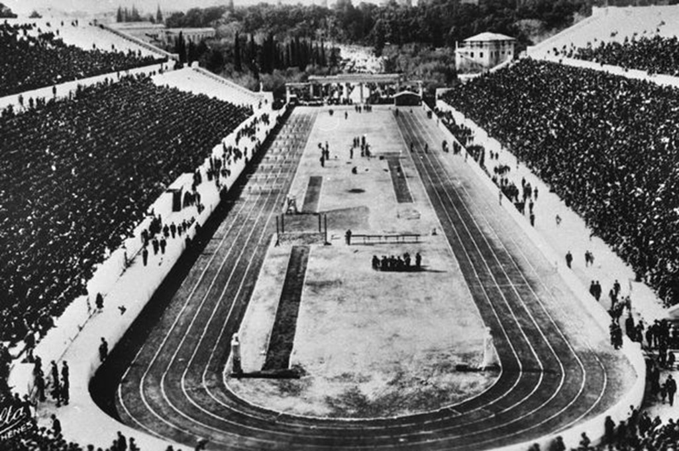

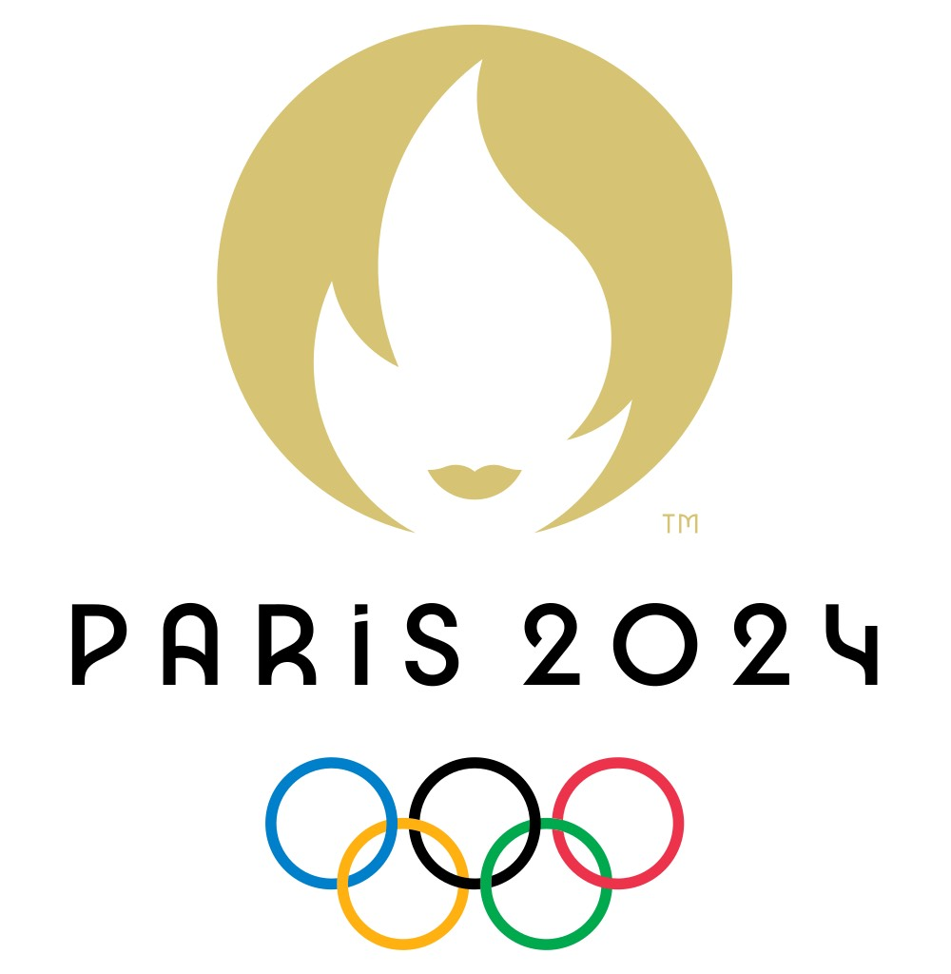
Motivations
The modern Olympics began in Athens in 1896 by the IOC, and scheduled to be held every 4 years.
The XXIII Olympiad began on 23 July – 8 August 2021 in Tokyo, after delays amid the COVID-19 pandemic and domestic controversy.
Fans and the media are alrDespite the circumstances, it was widely viewed as a success.
eady enthusiastic for the next games – including which country was the “overall winner” of each Olympic Games.
This is typically done with a medal tally.
Notes:
Firstly, I would like to give you some context about the Olympics.
The modern Olympic Games as we know it began in 1896 in Athens, as a revival of the ancient Olympic games which were originally held in Greece from 7th Century BC to 4th Century AD.
It was designed as a major international sporting event that celebrates professionalism and excellence in sport – but further to this, are the key principles of sustainability, universality and unity in diversity. It is hoped by the IOC that sport can be used as a tool to foster harmony and worldwide cooperation in these principles.
The Olympics have been held every 4 years since 1896, minus 4 cancellations and 1 postponement due to COVID-19. Tokyo 2020 was finally held this year, amid domestic controversy, but has been since hailed as a success given the circumstances. Every games, fans and the media are eager to declare which country is the overall winner of each Olympics, leading to some predictions to be made.
Typically this is done with a medal tally, and ranking each country by number of Gold medals won, followed by Silver and Bronze. An alternate way is to aggregate the total number of medals won by each country.

Slide 3
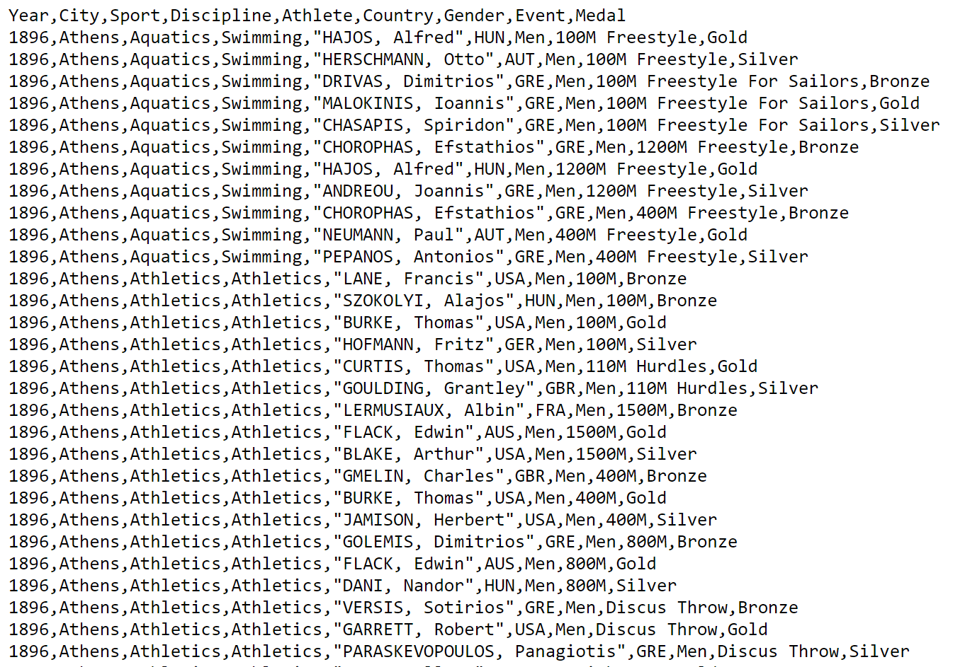
Overview of Data
We obtained a dataset (.CSV) of public Summer Olympics medal data until 2012, originally scraped from the IOC website and shared on Kaggle.
Mostly clean. May require separation of strings in sport categories.
Year | Olympic City | Sport | Discipline | Athlete Name | Country Code | Gender | Event | Medal Won
numeric (integer) | character (string) | character (category) | character (category) | character (string) | character (category) | character (category) | character (string) | character (category)
Notes:
The data set which we have obtained shows publicly available Summer Olympics data from 1986 to present.

Slide 4
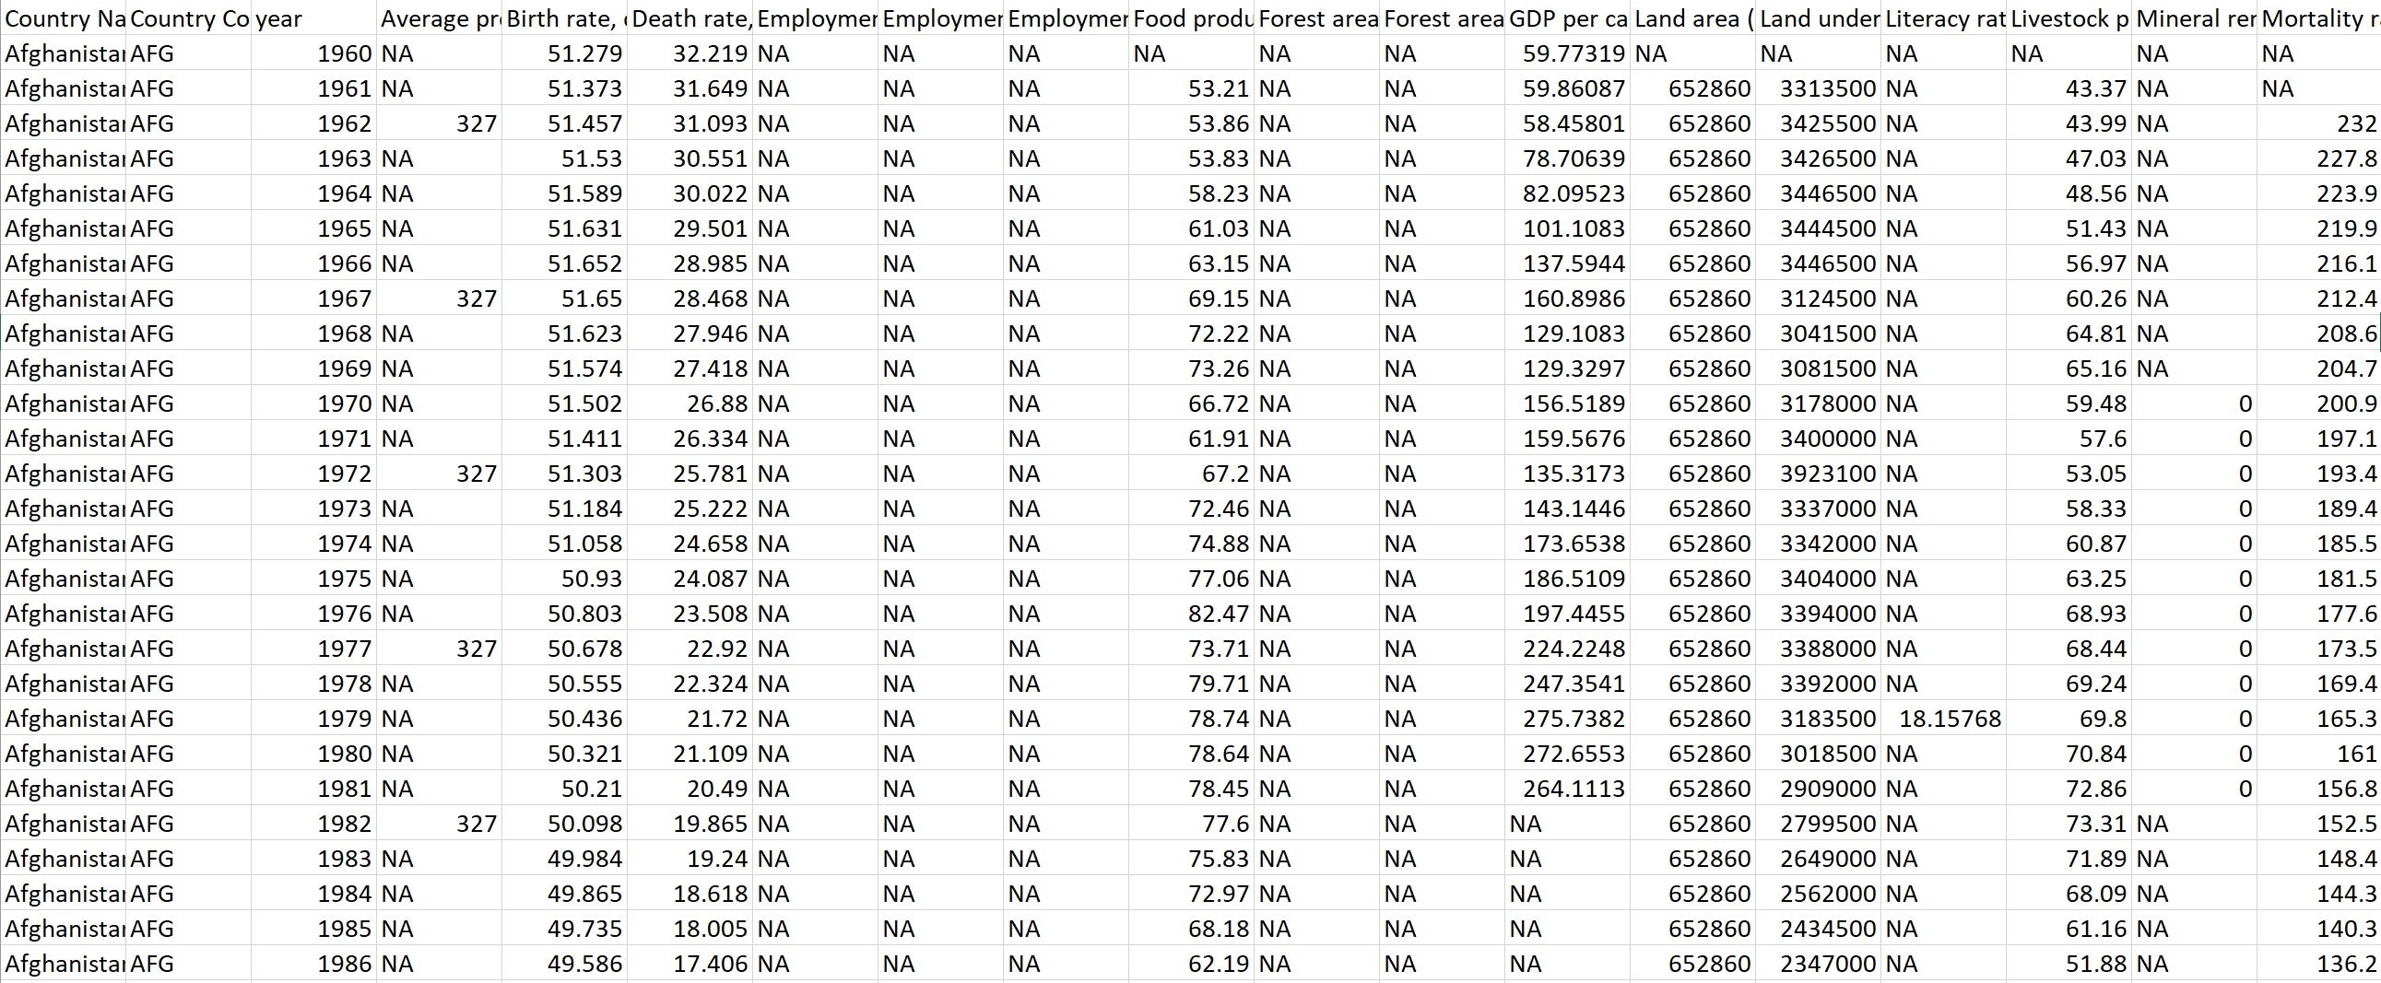
Overview of Data
We also have dataset (.CSV) containing world population statistics from World Bank and shared on Kaggle.
55 attributes, mostly unclean data and many blank/NA cells.
Country | Country Code | Year Data Obtained | Birth rate (per 1000) | Mortality rate (per 1000) | GDP per capita (US$) | Population | Surface Area | ...
character (string) | character (category) | numeric (integer) | numeric | numeric | numeric | numeric | numeric | …
Notes:
The second dataset which we have obtained is a CSV file containing world statistics from

Slide 5
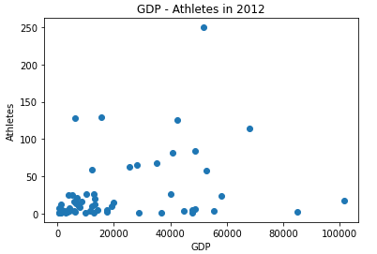
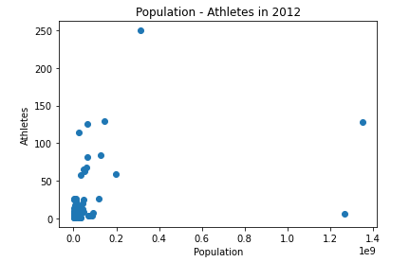
Initial Exploration
Notes:
After doing some initial data cleaning (for example, matching IOC country codes in both datasets) and obtaining the most recent population data for each country (not taking into account null entries) a number of scatter plots were made by Linyuan and Jingxin which displays GDP vs number of athletes sent by a country in 2012, country population vs athletes sent in 2012, and the number of male and female participants from 1986 to 2012.
In terms of athlete demographics, it is interesting to see the number of male participants reaching a peak prior to WW1, following a sharp decline – most likely due to the number of men that would have been enlisted in the war. Women have been steadily increasing in participation until the most recent data obtained.
When plotting each point as a country, the spread of the data implies there are a few outliers (China, USA, Russia being among them), and it would be worth zooming into the bottom left-hand corner to see the various clusters that are appearing through further exploration.
Timothy will speak next about the research questions we have uncovered from initial exploration.

Slide 6
Research Questions
How accurately can the number of medals won by each country be predicted, using Summer and Winter Olympic data combined with measures of a countries wealth and population?
What factors are most influential in understanding how many medals a country is likely to win?
Do these factors differ depending on the sport considered?

Slide 7
Methods
Linear regression
Country GDP vs medals won
Number of athletes vs medals won
Country population vs medals won and per capita analysis
K-means clustering
Do countries with higher GDP and population fall into the same groups when clustering?

Slide 8
expectations
Model should be fairly accurate. Our belief is that GDP and population are the main indicators.
Many other factors determine medals won as well. The importance of these other factors will be determined by the success of our models
We expect that we will have some time in the project to anlyse the effect of these other factors.

